Slide 1
Code Converters
A code converter is a logic circuit that changes data presented in one type of binary code to another type of binary code, such as BCD to binary, BCD to 7−segment, binary to BCD, BCD to XS3, binary to Gray code, and Gray code to binary.

Slide 2
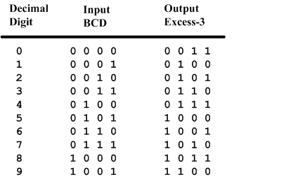
BCD-to-Excess-3 Code converter
BCD is a code for the decimal digits 0-9
Excess-3 is also a code for the decimal digits

Slide 3
Specification of BCD-to-Excess3
Inputs: a BCD input, A,B,C,D with A as the most significant bit and D as the least significant bit.
Outputs: an Excess-3 output W,X,Y,Z that corresponds to the BCD input.
Internal operation – circuit to do the conversion in combinational logic.

Slide 4
Formulation of BCD-to-Excess-3
Excess-3 code is easily formed by adding a binary 3 to the binary or BCD for the digit.
There are 16 possible inputs for both BCD and Excess-3.
It can be assumed that only valid BCD inputs will appear so the six combinations not used can be treated as don’t cares.

Slide 5
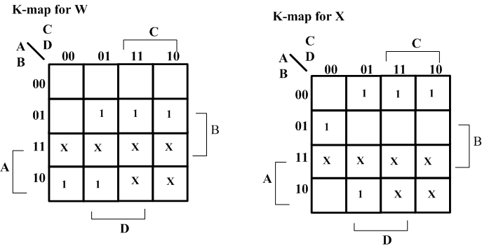
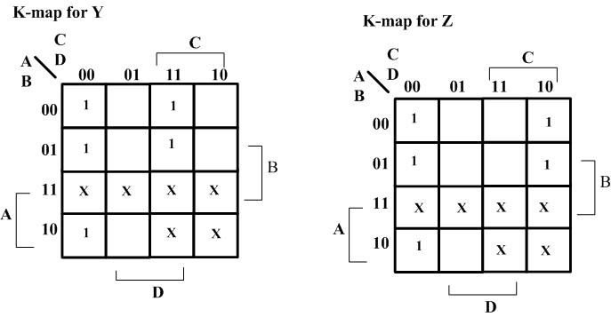
Optimization – BCD-to-Excess-3
Lay out K-maps for each output, W X Y Z
A step in the digital circuit design process.

Slide 6
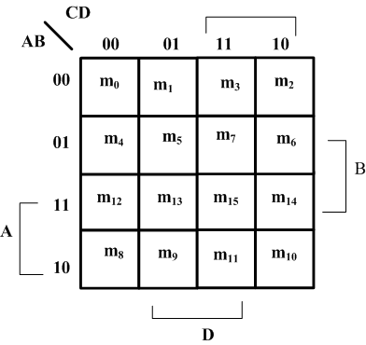
Placing 1 on K-maps
Where are the minterms located on a K-Map?

Slide 7
Expressions for W X Y Z
W(A,B,C,D) = Σm(5,6,7,8,9) +d(10,11,12,13,14,15)
X(A,B,C,D) = Σm(1,2,3,4,9) +d(10,11,12,13,14,15)
Y(A,B,C,D) = Σm(0,3,4,7,8) +d(10,11,12,13,14,15)
Z(A,B,C,D) = Σm(0,2,4,6,8) +d(10,11,12,13,14,15)

Slide 8
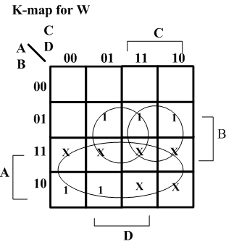
Minimize K-Maps
W minimization
Find W = A + BC + BD

Slide 9
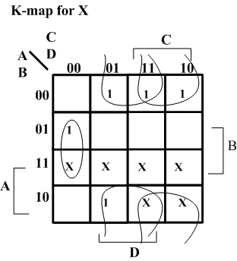
Minimize K-Maps
X minimization
Find X = BC’D’+B’C+B’D

Slide 10
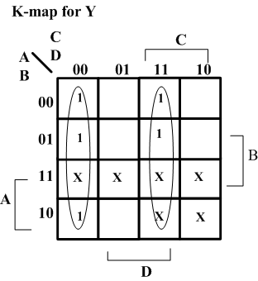
Minimize K-Maps
Y minimization
Find Y = CD + C’D’

Slide 11
Two level circuit implementation
Have equations
W = A + BC + BD = A + B(C+D)
X = B’C + B’D + BC’D’ = B’(C+D) + BC’D’
Y = CD + C’D’
Z = D’
Factoring out (C+D) and call it T
Then T’ = (C+D)’ = C’D’
W = A + BT
X = B’T + BT’
Y = CD + T’
Z = D’

Slide 12
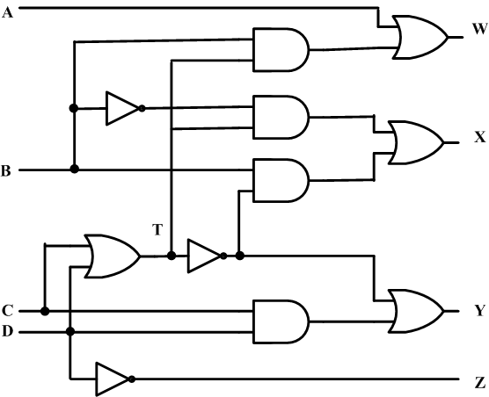
Create the digital circuit
Implementing the second set of equations where T=C+D results in a lower gate count.
This gate has a fanout of 3

Slide 13
FOUR BIT BINARY TO GRAY CODE CONVERTER –DESIGN (1)…
MSB
0
+
1
+
1
+
0
+
1
Binary code
TRUTH TABLE:
0
1
0
1
1
Gray code
INPUT ( BINARY) |  |  |  |  | OUTPUTS (GRAY CODE)
B3 | B2 | B1 | B0 |  | G3 | G2 | G1 | G0
0 | 0 | 0 | 0 | 0 | 0 | 0 | 0 | 0
0 | 0 | 0 | 1 | 1 | 0 | 0 | 0 | 1
0 | 0 | 1 | 0 | 2 | 0 | 0 | 1 | 1
0 | 0 | 1 | 1 | 3 | 0 | 0 | 1 | 0
0 | 1 | 0 | 0 | 4 | 0 | 1 | 1 | 0
0 | 1 | 0 | 1 | 5 | 0 | 1 | 1 | 1
0 | 1 | 1 | 0 | 6 | 0 | 1 | 0 | 1
0 | 1 | 1 | 1 | 7 | 0 | 1 | 0 | 0
1 | 0 | 0 | 0 | 8 | 1 | 1 | 0 | 0
1 | 0 | 0 | 1 | 9 | 1 | 1 | 0 | 1
1 | 0 | 1 | 0 | 10 | 1 | 1 | 1 | 1
1 | 0 | 1 | 1 | 11 | 1 | 1 | 1 | 0
1 | 1 | 0 | 0 | 12 | 1 | 0 | 1 | 0
1 | 1 | 0 | 1 | 13 | 1 | 0 | 1 | 1
1 | 1 | 1 | 0 | 14 | 1 | 0 | 0 | 1
1 | 1 | 1 | 1 | 15 | 1 | 0 | 0 | 0

Slide 14
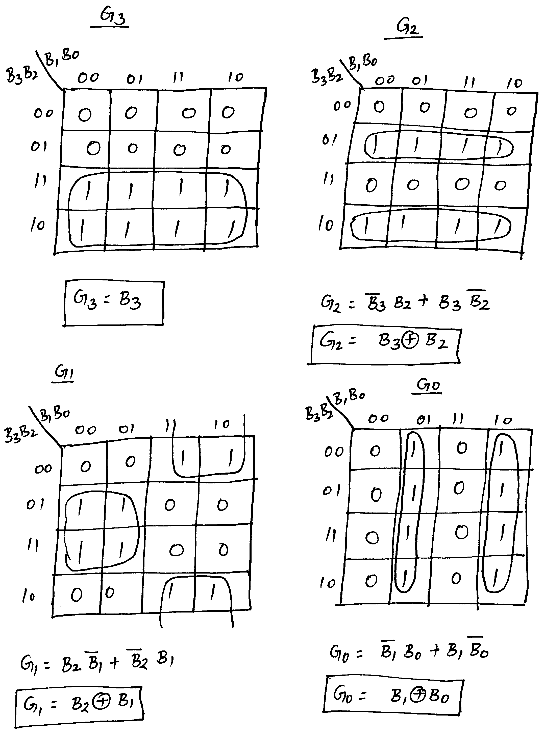
FOUR BIT BINARY TO GRAY CODE CONVERTER –DESIGN (2)…
Simplification using K-maps:

Slide 15
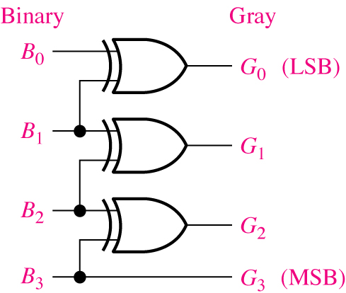
FOUR BIT BINARY TO GRAY CODE CONVERTER –DESIGN (3)
Logic Diagram:

Slide 16
COMPARATORS
Comparator is a combinational logic circuit that compares the magnitudes of two binary quantities to determine which one has the greater magnitude.
In other word, a comparator determines the relationship of two binary quantities.
A exclusive−OR gate can be used as a basic comparator.

Slide 17
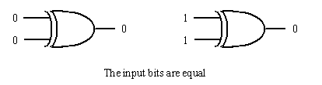
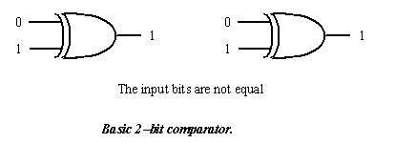
If two input bits are not equal, its output is a 1. But if
two input bits are equal, its output is a 0.
So exclusive−OR gate can be used as a 2−bit Comparator.

Slide 18
1 bit comparator
Truth Table
A B f (A>B) f (A=B) f (A<B)
0 0 0 1 0
1 0 1 0 0
0 1 0 0 1
1 1 0 1 0

Slide 19
1 bit comparator
And now we find the equations using K-maps each for f (A>B), f (A=B) and f (A<B)

Slide 20
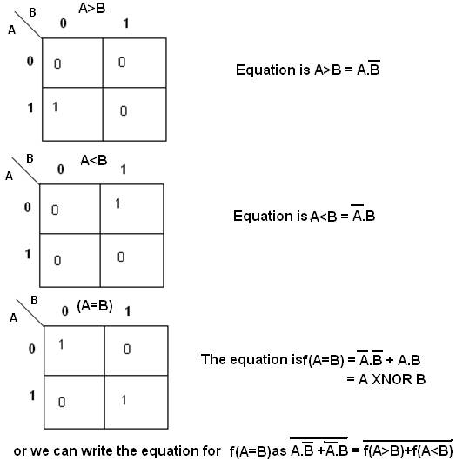

Slide 21
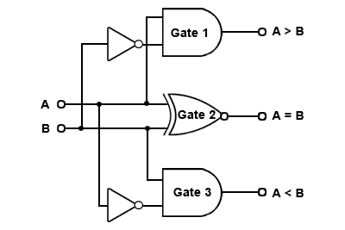

Slide 22
2 bit comparator
A B f (A>B) f (A=B) f (A<B)
00 00 0 1 0
01 00 1 0 0
10 00 1 0 0
11 00 1 0 0
00 01 0 0 1
01 01 0 1 0
10 01 1 0 0
11 01 1 0 0
00 10 0 0 1
01 10 0 0 1
10 10 0 1 0
11 10 1 0 0
00 11 0 0 1
01 11 0 0 1
10 11 0 0 1
11 11 0 1 0

Slide 23
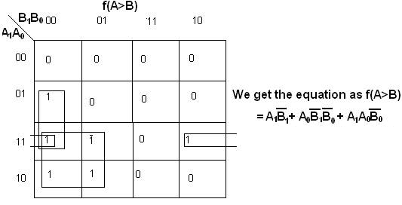
2 bit comparator

Slide 24
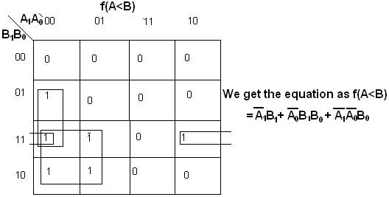
2 bit comparator

Slide 25
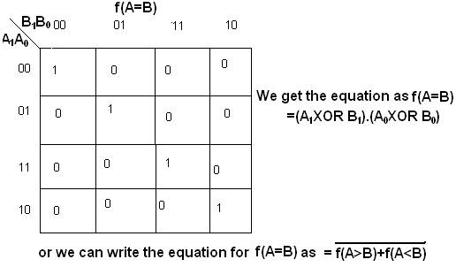
2 bit comparator

Slide 26
4 bit comparator
Start with most significant bit in each number to determine the inequality of 4-bit binary numbers A and B
Output A<B will be HIGH if A₃=0, and B₃=1
Output A>B will be HIGH if A₃=1, and B₃=0
If A₃=0, and B₃=0 or A₃=1, and B₃=1, then examine the next lower order bit position for an inequality.Only when all bits of A=B, output A=B will be HIGH

Slide 27
4 bit comparator
The general procedure used in comparator:
Start with the highest-order bits (MSB)
When an inequality is found, the relationship of the 2
numbers is established, and any other inequalities in lower-
order positions must be ignored
THE HIGHEST ORDER INDICATION MUST TAKE
PRECEDENCE

Slide 28
4 bit comparator
In addition, it also has three cascading inputs:
These inputs provides a means for expanding the comparison operation by cascading two or more 4−bit comparator.
To expand the comparator, the A<B, A=B, and A>B outputs of the lower−order comparator are connected to the corresponding cascading inputs of the next higher−order comparator.

Slide 29
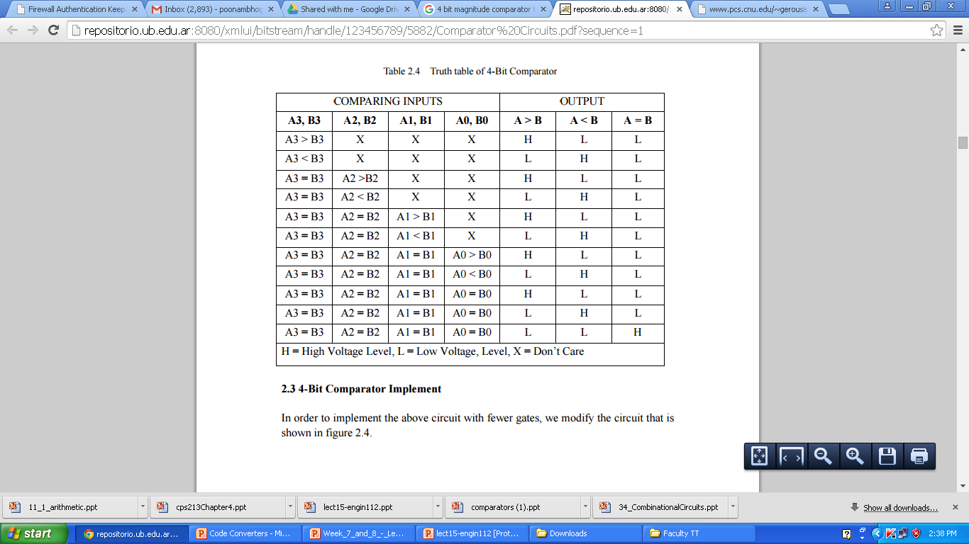

Slide 30
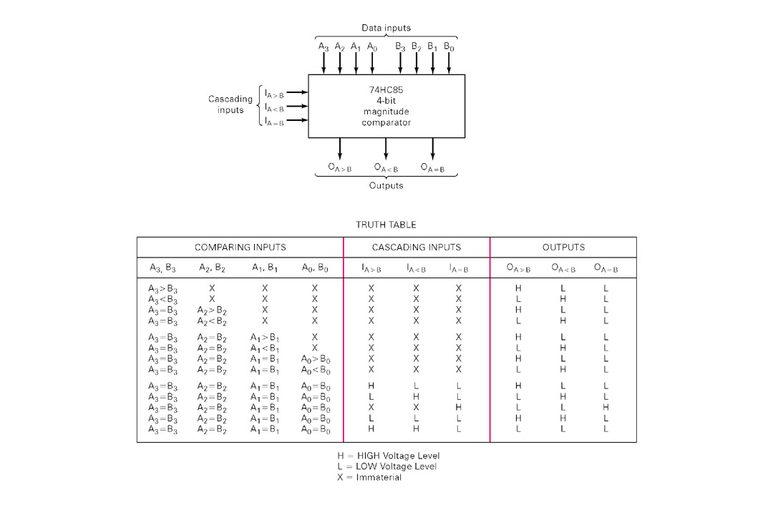

Slide 31
Decoder
Accepts a value and decodes it
Output corresponds to value of n inputs
Consists of:
Inputs (n)
Outputs (2^{n} , numbered from 0 → 2^{n} - 1)
Selectors / Enable (active high or active low)

Slide 32
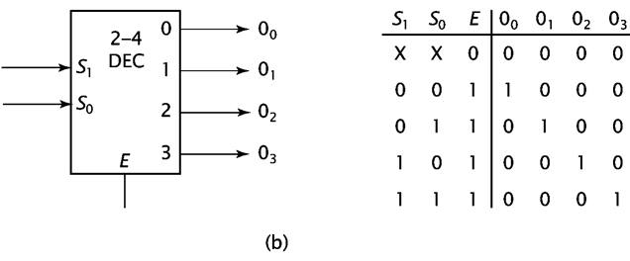
The truth table of 2-to-4 Decoder

Slide 33
2-to-4 Decoder

Slide 34
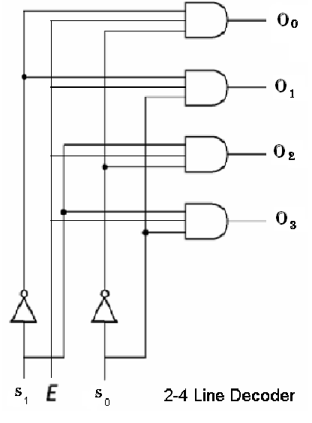
2-to-4 Decoder

Slide 35
The truth table of 3-to-8 Decoder
A2 | A1 | A0 | D0 | D1 | D2 | D3 | D4 | D5 | D6 | D7
0 | 0 | 0 | 1
0 | 0 | 1 |  | 1
0 | 1 | 0 |  |  | 1
0 | 1 | 1 |  |  |  | 1
1 | 0 | 0 |  |  |  |  | 1
1 | 0 | 1 |  |  |  |  |  | 1
1 | 1 | 0 |  |  |  |  |  |  | 1
1 | 1 | 1 |  |  |  |  |  |  |  | 1

Slide 36
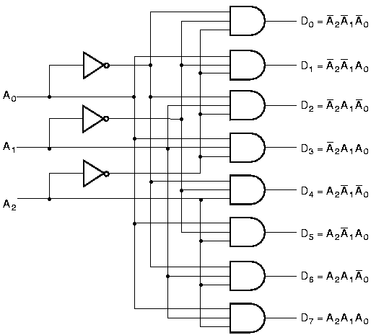
3-to-8 Decoder

Slide 37
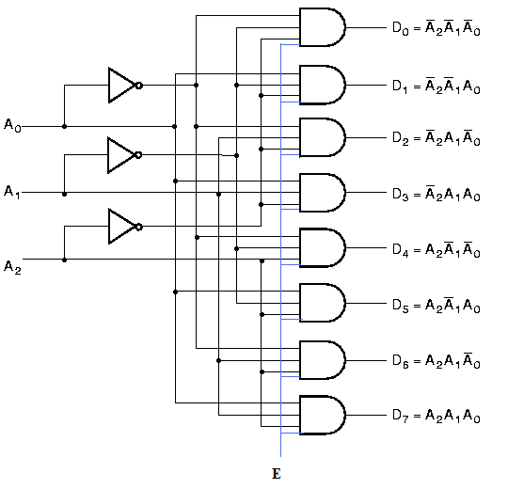
3-to-8 Decoder with Enable

Slide 38
Decoder Expansion
Decoder expansion
Combine two or more small decoders with enable inputs to form a larger decoder
3-to-8-line decoder constructed from two 2-to-4-line decoders
The MSB is connected to the enable inputs
if A₂=0, upper is enabled; if A₂=1, lower is enabled.

Slide 39
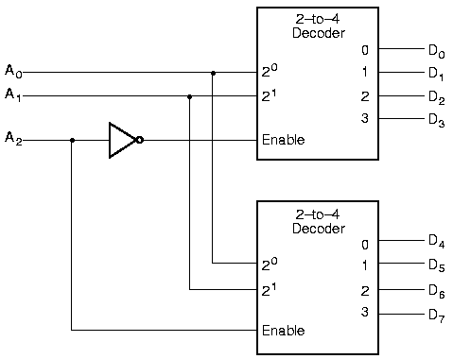
Decoder Expansion

Slide 40
MULTIPLEXERS AND DEMULTIPLEXERS

Slide 41
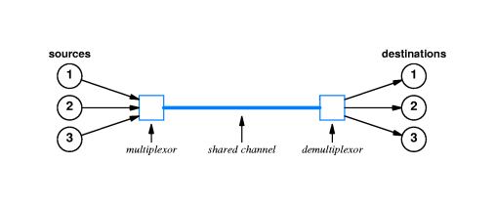
Mutiplexing
Multiplexing allows one to select one of the many possible sources.

Slide 42
I₀
I₁
Z
2^{n} : 1
S_{n-1}
S₁
S₀
In general for a 2^{n}:1 MUX with control signals/inputs
S_{n-1} ··· S₁S₀ & “data” inputs I₀, ···, ,
Z = I_{i} when S_{n-1} ··· S₁S₀ combination represents #i in binary.

Slide 43
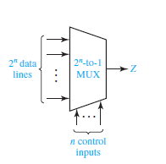
Multiplexers

Slide 44
2:1 Multiplexer
Number of inputs=2
Number of outputs=1
Number of selection lines=1
I₀
2:1
MUX
Z
I₁
S₀

Slide 45
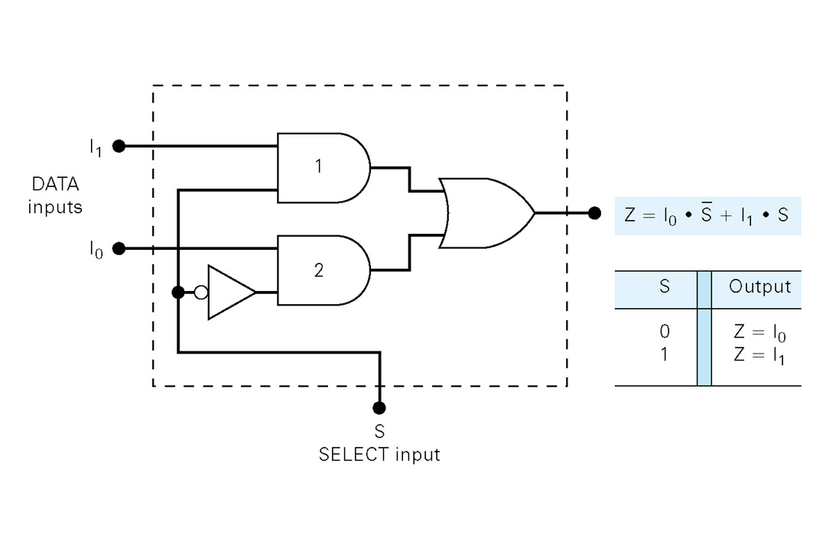
2:1 Multiplexer

Slide 46
4:1 Multiplexer
Number of inputs=4
Number of outputs=1
Number of selection lines=2
I₀
Z
I₁
4:1
MUX
I₂
I₃
S₁
S₀

Slide 47
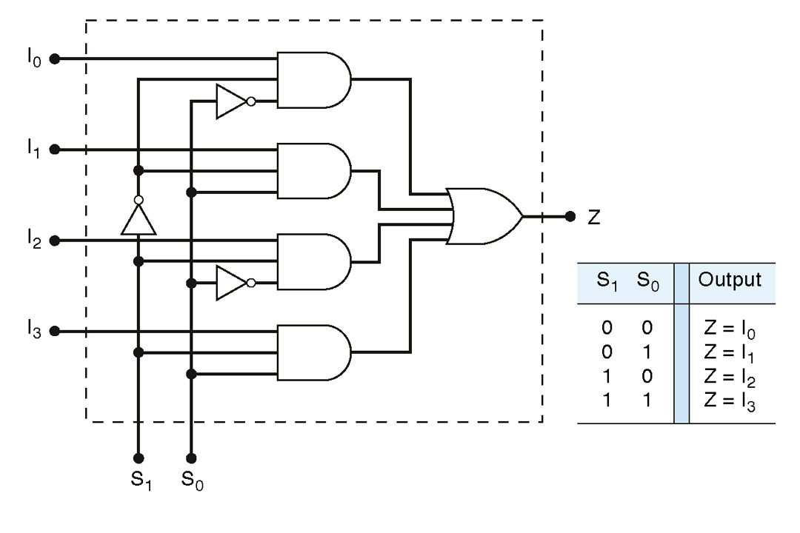
4:1 Multiplexer
I₀
I₁
I₂
I₃
S₁
S₀
Z=S₀’S₁’IO+S₀S₁’I1+S₀’S₁I2+S₀S₁I3

Slide 48
8:1 Multiplexer
Number of inputs=8
Number of outputs=1
Number of selection lines=3
I
0
I
1
I
2
I
3
8:1
I
mux
4
I
5
I
6
I
7
S₂
S₁
S₀

Slide 49
8:1 Multiplexer
S2 | S1 | S0 | ENABLE E | OUTPUT Y
X | X | X | 0 | 0
0 | 0 | 0 | 1 | I₀
0 | 0 | 1 | 1 | I₁
0 | 1 | 0 | 1 | I₂
0 | 1 | 1 | 1 | I₃
1 | 0 | 0 | 1 | I₄
1 | 0 | 1 | 1 | I₅
1 | 1 | 0 | 1 | I₆
1 | 1 | 1 | 1 | I₇
Y=S₂’S₁’S₀’I₀+S₂’S₁’S₀I₁+S₂’S₁S₀’I₂+S₂’S₁S₀I₃ +S₂S₁’S₀’I₄+S₂S₁’S₀ I₅+S₂S₁S₀’ I₆+S₂S₁S₀ I₇

Slide 50
DEMULTIPLEXER
Z
1: 2^{n} Demux
x
One Input Line
S_{n-1}
S₁
S₀

Slide 51
1:4 Demultiplexer
Input Line | S1 | S0 | Y₀ | Y₁ | Y₂ | Y₃
I | 0 | 0 | I | 0 | 0 | 0
I | 0 | 1 | 0 | I | 0 | 0
I | 1 | 0 | 0 | 0 | I | 0
I | 1 | 1 | 0 | 0 | 0 | I
Y=S₂’S₁’S₀’I₀+S₂’S₁’S₀I₁+S₂’S₁S₀’I₂+S₂’S₁S₀I₃ +S₂S₁’S₀’I₄+S₂S₁’S₀ I₅+S₂S₁S₀’ I₆+S₂S₁S₀ I₇

Slide 52
1:8 Demultiplexer
Input Line | S2 | S1 | S0 | Y₀ | Y₁ | Y₂ | Y₃ | Y₄ | Y₅ | Y₆ | Y₇
I | 0 | 0 | 0 | I | 0 | 0 | 0 | 0 | 0 | 0 | 0
I | 0 | 0 | 1 | 0 | I | 0 | 0 | 0 | 0 | 0 | 0
I | 0 | 1 | 0 | 0 | 0 | I | 0 | 0 | 0 | 0 | 0
I | 0 | 1 | 1 | 0 | 0 | 0 | I | 0 | 0 | 0 | 0
I | 1 | 0 | 0 | 0 | 0 | 0 | 0 | I | 0 | 0 | 0
I | 1 | 0 | 1 | 0 | 0 | 0 | 0 | 0 | I | 0 | 0
I | 1 | 1 | 0 | 0 | 0 | 0 | 0 | 0 | 0 | I | 0
I | 1 | 1 | 1 | 0 | 0 | 0 | 0 | 0 | 0 | 0 | I
Y=S₂’S₁’S₀’I₀+S₂’S₁’S₀I₁+S₂’S₁S₀’I₂+S₂’S₁S₀I₃ +S₂S₁’S₀’I₄+S₂S₁’S₀ I₅+S₂S₁S₀’ I₆+S₂S₁S₀ I₇

Slide 53
Decoders
A decoder has
N inputs
2^{N} outputs
A decoder selects one of 2^{N} outputs by decoding the binary value on the N inputs.
Exactly one output will be active for each combination of the inputs.

Slide 54
Decoders
A decoder has
N inputs
2^{N} outputs
Size of the Decoder-
“n X m lines”
“n to m lines”

Slide 55
Decoders
A decoder is a multiple-input, multiple-output combinational logic circuit that converts coded inputs into coded outputs, where the input and output codes are different.
N input lines
n:2^{n}
decoder
M Output Lines
Where m=2^{n}
Enable

Slide 56
2 to 4 Binary Decoder
Truth table for a 2-to-4 binary decoder
Inputs | Outputs
EN I1 I0 | Y3 Y2 Y1 Y0
0 X X 1 0 0 1 0 1 1 1 0 1 1 1 | 0 0 0 0 0 0 0 1 0 0 1 0 0 1 0 0 1 0 0 0
2-to-4
Decoder
I0 Y0
I1 Y1
Y2
EN Y3
”don’t-care” notation

Slide 57
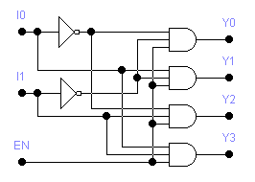
2 to 4 Decoder

Slide 58
3 TO 8 DECODER
No of Input Lines=3
No of Output Lines=8
Also 3x8 Decoder
3 line to 8 Line decoder
Binary to Octal Decoder
A | B | C | I7 | I6 | I5 | I4 | I3 | I2 | I1 | I0
0 | 0 | 0 | 0 | 0 | 0 | 0 | 0 | 0 | 0 | 1
0 | 0 | 1 | 0 | 0 | 0 | 0 | 0 | 0 | 1 | 0
0 | 1 | 0 | 0 | 0 | 0 | 0 | 0 | 1 | 0 | 0
0 | 1 | 1 | 0 | 0 | 0 | 0 | 1 | 0 | 0 | 0
1 | 0 | 0 | 0 | 0 | 0 | 1 | 0 | 0 | 0 | 0
1 | 0 | 1 | 0 | 0 | 1 | 0 | 0 | 0 | 0 | 0
1 | 1 | 0 | 0 | 1 | 0 | 0 | 0 | 0 | 0 | 0
1 | 1 | 1 | 1 | 0 | 0 | 0 | 0 | 0 | 0 | 0

Slide 59
3 TO 8 DECODER
A | B | C | I7 | I6 | I5 | I4 | I3 | I2 | I1 | I0
0 | 0 | 0 | 0 | 0 | 0 | 0 | 0 | 0 | 0 | 1
0 | 0 | 1 | 0 | 0 | 0 | 0 | 0 | 0 | 1 | 0
0 | 1 | 0 | 0 | 0 | 0 | 0 | 0 | 1 | 0 | 0
0 | 1 | 1 | 0 | 0 | 0 | 0 | 1 | 0 | 0 | 0
1 | 0 | 0 | 0 | 0 | 0 | 1 | 0 | 0 | 0 | 0
1 | 0 | 1 | 0 | 0 | 1 | 0 | 0 | 0 | 0 | 0
1 | 1 | 0 | 0 | 1 | 0 | 0 | 0 | 0 | 0 | 0
1 | 1 | 1 | 1 | 0 | 0 | 0 | 0 | 0 | 0 | 0
I0=A’B’C’
I1=A’B’C
I2=A’BC’
I3=A’BC
I4=AB’C’
I5=AB’C
I6=ABC’
I7=ABC

